Slide 1
CHAPTER 7
STRINGS

Slide 2
COMPOUND DATA TYPE
Strings are qualitatively different from Integer and Float type.
Characters which collectively form a String is a Compound Data Type.
For Eg.
fruit = “apple”
letter = fruit[1]
print (letter)
Output : p // (index value starts from 0 as in C & C++)

Slide 3
LENGTH OF STRINGS
The inbuilt function to find the length of a string is ‘len()’.
For Eg.
fruit = “banana”
len(fruit)
Output : 6
To get the last letter we might try
length = len(fruit)
last = fruit[length] #ERROR
( because there is no character at 6th place)

Slide 4
LENGTH OF STRINGS (to be continued…..)
Right Method to do this is :
length = len(fruit)
last = fruit[length-1]
Another way to get the elements from last is :
fruit[-1] # yields the last letter
fruit[-2] # yields the second last letter

Slide 5
TRAVERSAL USING WHILE LOOP
Processing one character at one time.
For Eg.
index = 0
while index < len(fruit):
letter = fruit[index]
print (letter)
index = index + 1
(Take care of the indentation)

Slide 6
TRAVERSAL USING FOR LOOP
For loop provides us a privilege to access the characters without using index.
For Eg.
fruit=“apple”
for char in fruit:
print (char)
(Each time through the loop a character is assigned to the variable char)

Slide 7
TRAVERSAL USING FOR LOOP (to be continued…..)
ABECEDARIAN SERIES – Print using for loop
A series or list in which the elements appear in alphabetical order.
For Eg. In Robert McCloskey’s book Make way for Duckings the names of the ducklings were Jack, Kack, Lack, Mack, Nack, Ouack, Pack, Quack
To print them in order the code is :
prefixes = “JKLMNOPQ”
suffix = “ack”
Notes:
for letter in prefixes:
print letter+suffix

Slide 8
STRING SLICES
A segment of a string is called a slice, i.e. a character.
The syntax to select a slice from a string is a[n:m], where a contains strings, n is the starting index and m is the end index.
Includes the first index and excluding the last index.
Eg:
s= “Peter, Paul, and Mary”
print s =[0:5] # Peter
print s =[7:11] # Paul
print s =[17:21] # Mary

Slide 9

STRING SLICES (to be continued…..)
fruit = “banana”
fruit[ : 3] #ban
fruit[ 3 :] #ana
fruit[:] ?

Slide 10
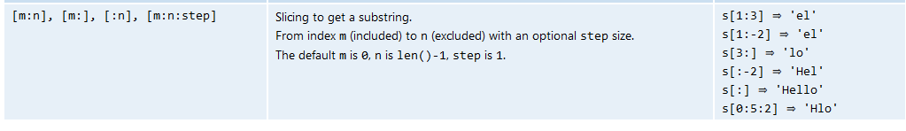
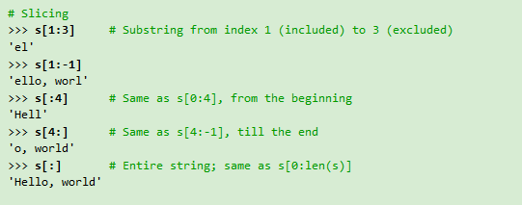

Slide 11
STRING COMPARISON
Equality Comparison
if word ==“banana!”
Other Comparisons
if word < “banana”:
print ”Your word,”+ word + “,comes before banana.”
elif word > “banana”:
print ”Your word,”+ word + “,comes after banana.”

Slide 12
STRING COMPARISON (to be continued…..)
> and < comparison operations are useful for putting words in alphabetical order:
Uppercase letters ,numerals and special symbol comes before Lowercase letters in Python.
Need to maintain a standard format of the strings.

Slide 13
STRINGS ARE IMMUTABLE
An existing string cannot be modified.
For Eg :
greeting = "Hello, world!“ greeting[0] = ’J’ # ERROR! print greeting
Output : Hello, world

Slide 14
STRINGS ARE IMMUTABLE (to be continued….)
The Solution of the problem is
greeting = "Hello, world!“ newGreeting = ’J’ + greeting[1:] print newGreeting
Output : Jello, World
The original string remains intact.

Slide 15
Creation of Find Function in Strings
Find function is used to find the index of a particular character inside the string, else it returns void.
It is opposite to that of the [] operator.
def find(str, ch): index = 0 while index < len(str): if str[index] == ch: return index index = index + 1 return -1

Slide 16
LOOPING AND COUNTING
For and while loops can be used for looping and counting.
The following code counts the no of times a appears in the string.
fruit = “grapes" count = 0 for char in fruit: if char == ’a’: count = count + 1 print (count)
Output : 1

Slide 17
STRING MODULE
String module is a package which contains useful functions for manipulating strings.
To use the string module we need to import it first by using the following line of code i.e.
from string import*
Find Function : This inbuilt function finds the index of the character in the string.
fruit = “guava”
index = fruit.find(”a”)
Output : 2

Slide 18
STRING MODULE (to be continued….)
Find Function :
Try out
A=“Banana”
A.find(”na”) #2
A.find(”na”,3) #4, (starts from index 3)
A.find(”b”,1,3) #-1, (checks between 1 to 3 excluding 3 index)

Slide 19
CHARACTER CLASSIFICATION
Character Classification is a recognition of character (lowercase or uppercase) or it’s a digit.
String module provides several constants that are useful for these purposes.
string.lowercase contains all the letters that the system considers to be lowercase.
string.uppercase contains all the letters that the system considers to be uppercase.
    From string import*
print ascii_lowercase
print ascii_uppercase
print digits

Slide 20
Three ways to recognize lowercase
Method 1 :
def isLower(ch): return string.ascii_lowercase.find(ch) != -1
Method 2 :
def isLower(ch): return ch in string.ascii_lowercase
Method 3 :
def isLower(ch): return ’a’ <= ch <= ’z’

Slide 21
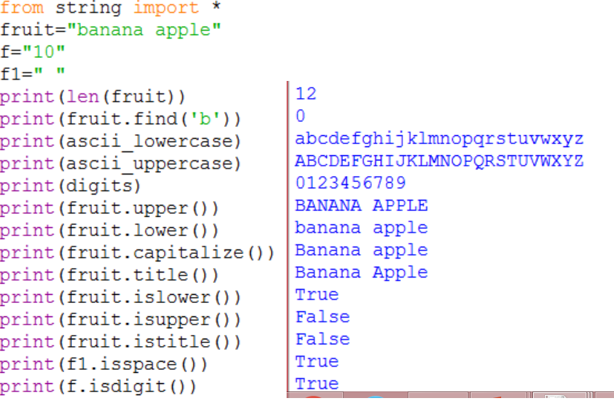
String Operations

Slide 22
Assignment Questions:
WAP to find a sub string and capitalize it
WAP to validate mobile no given by user
WAP to validate Email id given by user

